Slide 1
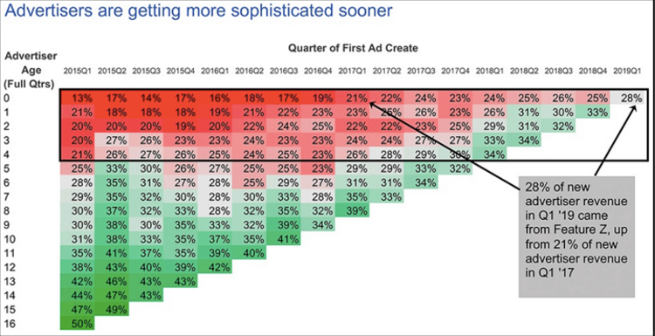
Feature Z Graph – Before Implementing Graphing Principles Improvements

Slide 2
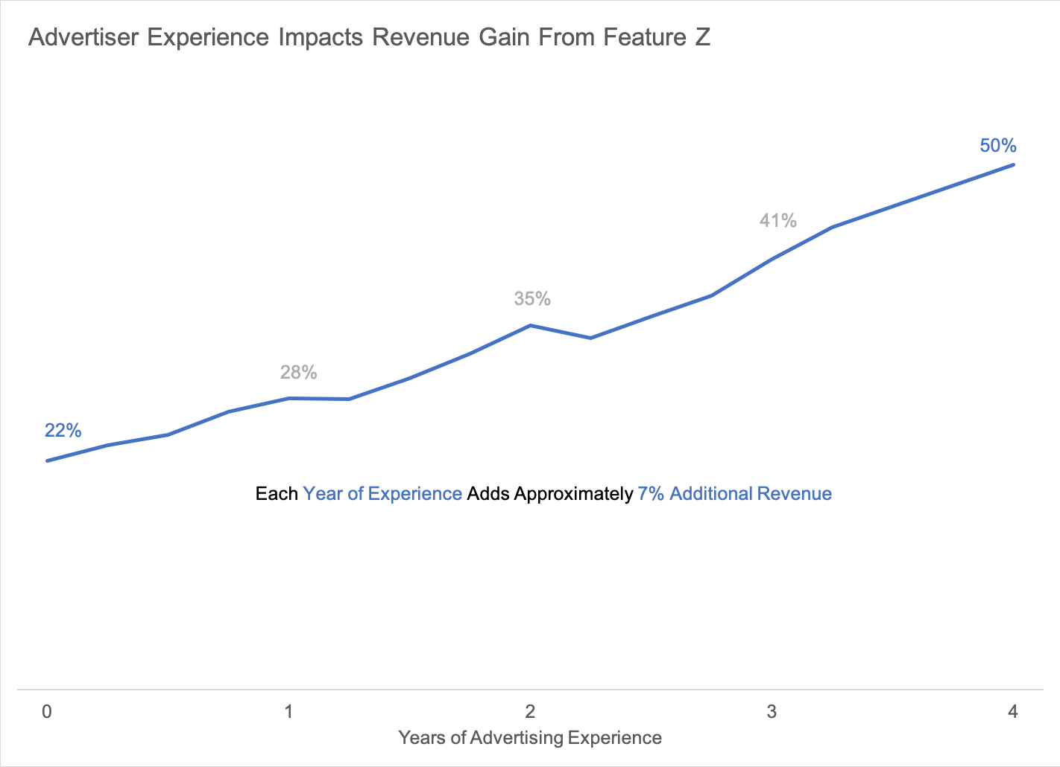
Feature Z Graph – After Implementing Graphing Principles Improvements

